Slide 1

2025-26 Scholarship Informational Webinar
October 15, 2025

Slide 2
Introductions & Setting the Stage
The Scholarship
Stories from Alumni & Trustees
Question & Answers

Slide 3
How many Strauss Scholars are there?
The Donald A. Strauss Scholarship Foundation awarded its first Scholarships in April 1997.
As of the 2025 awards, 360 projects have been funded.
60 were shared projects, so there are a total of 420 Strauss Scholars.

Slide 4
The Scholarship
The Donald A. Strauss Scholarship Foundation awards $15,000 to as many as 15 outstanding students to pursue their projects of public service and social change.
Up to $7,000 of the award can be applied to the Scholar’s school tuition and expenses.

Slide 5
Are You Eligible?
Do you attend a accredited 4 year California university/college?
Do you have one or two years remaining until Graduation?
Are you a full-time student with a GPA in the top one-third of their class?
Have you demonstrated a passion for making a difference in the area to be pursued?

Slide 6
What Is In the Application?
Application Summary (download form from website)
One page Resume
One page Personal Essay
4 page Proposal, which includes a Timeline and a Budget
2 Letters of Recommendation
  If the project is to be done with a partner institution, a Letter of Support from that organization’s leadership.
Transcript
Acceptance Agreement (download form from the website)

Slide 7
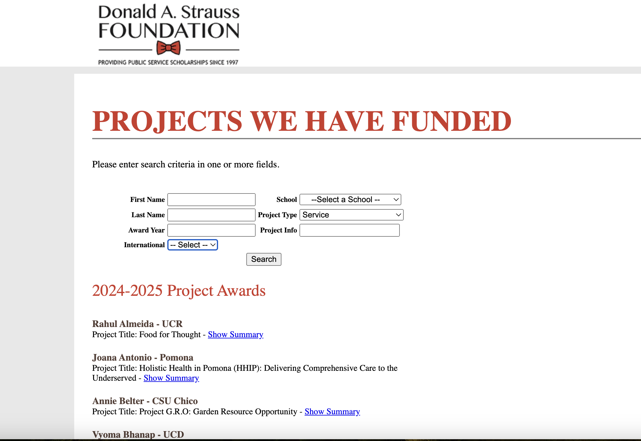
Notes:
Resources: webiste www.Straussfoundation.org- Projects- All Projects We Have Funded

Slide 8
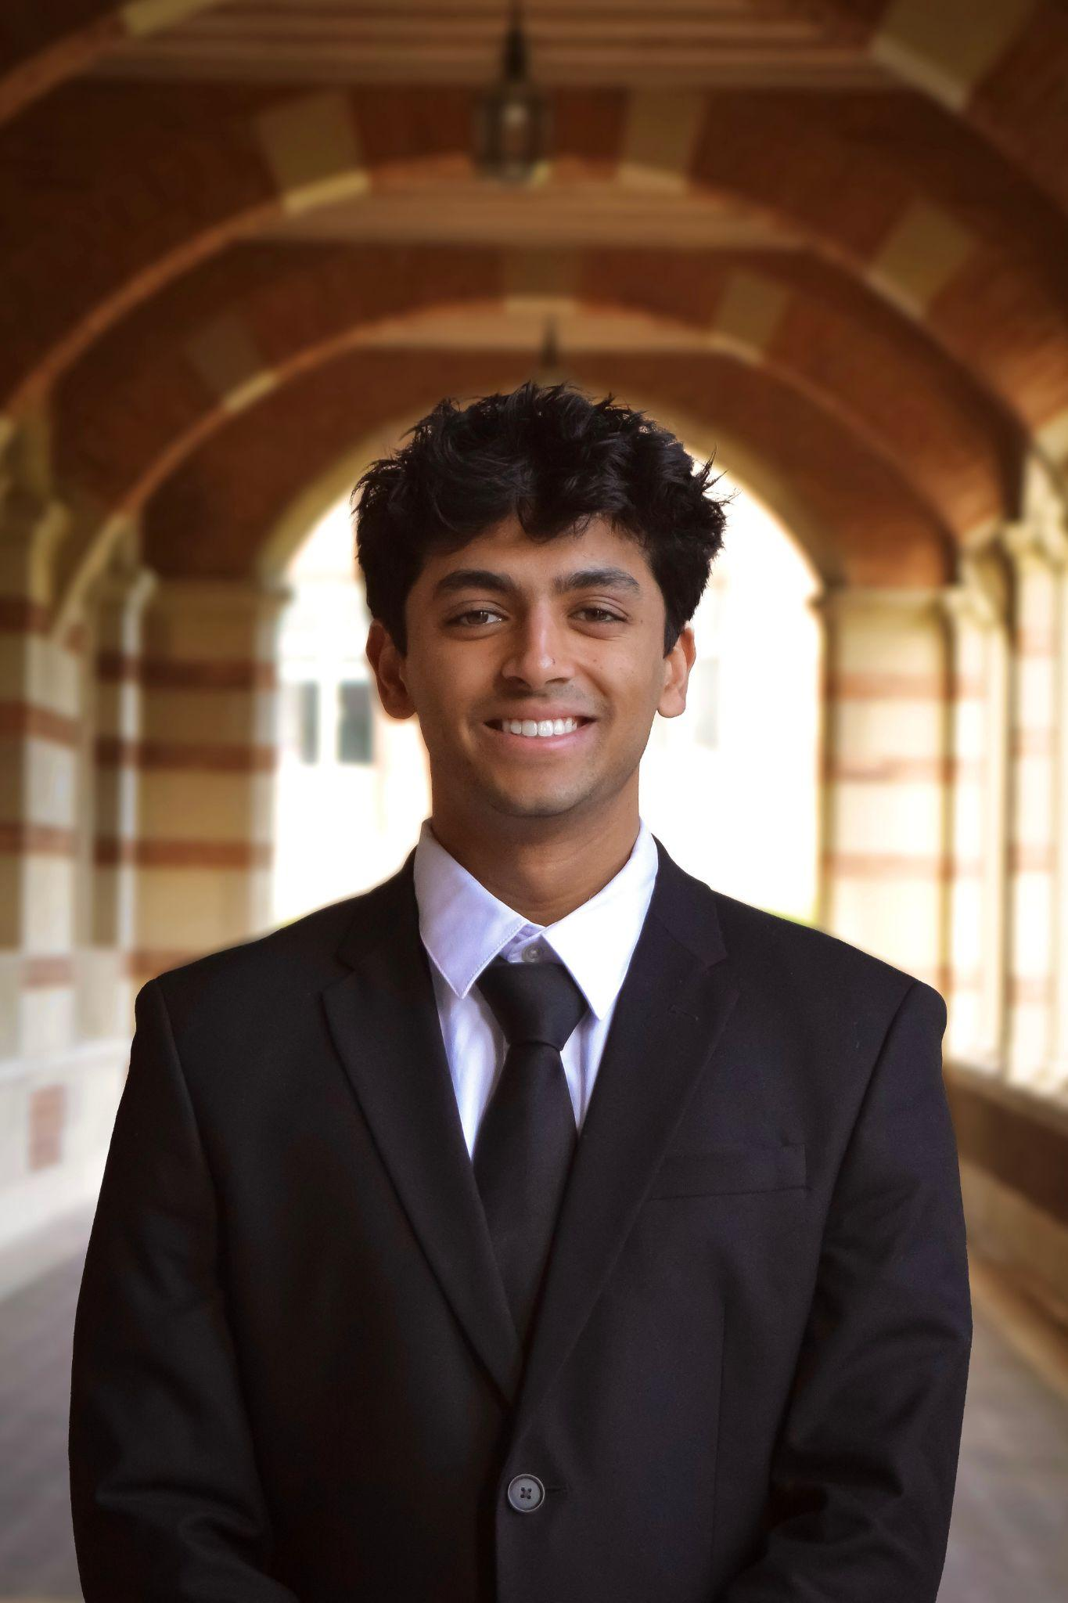

Empowering Children with Neurofibromatosis through Art
Shilp Shah, 2023 Scholar - UCLA
Notes:
Ryland King- 2011 Scholar U C Santa Barbara- Environmental Education for the Next Generation

Slide 9
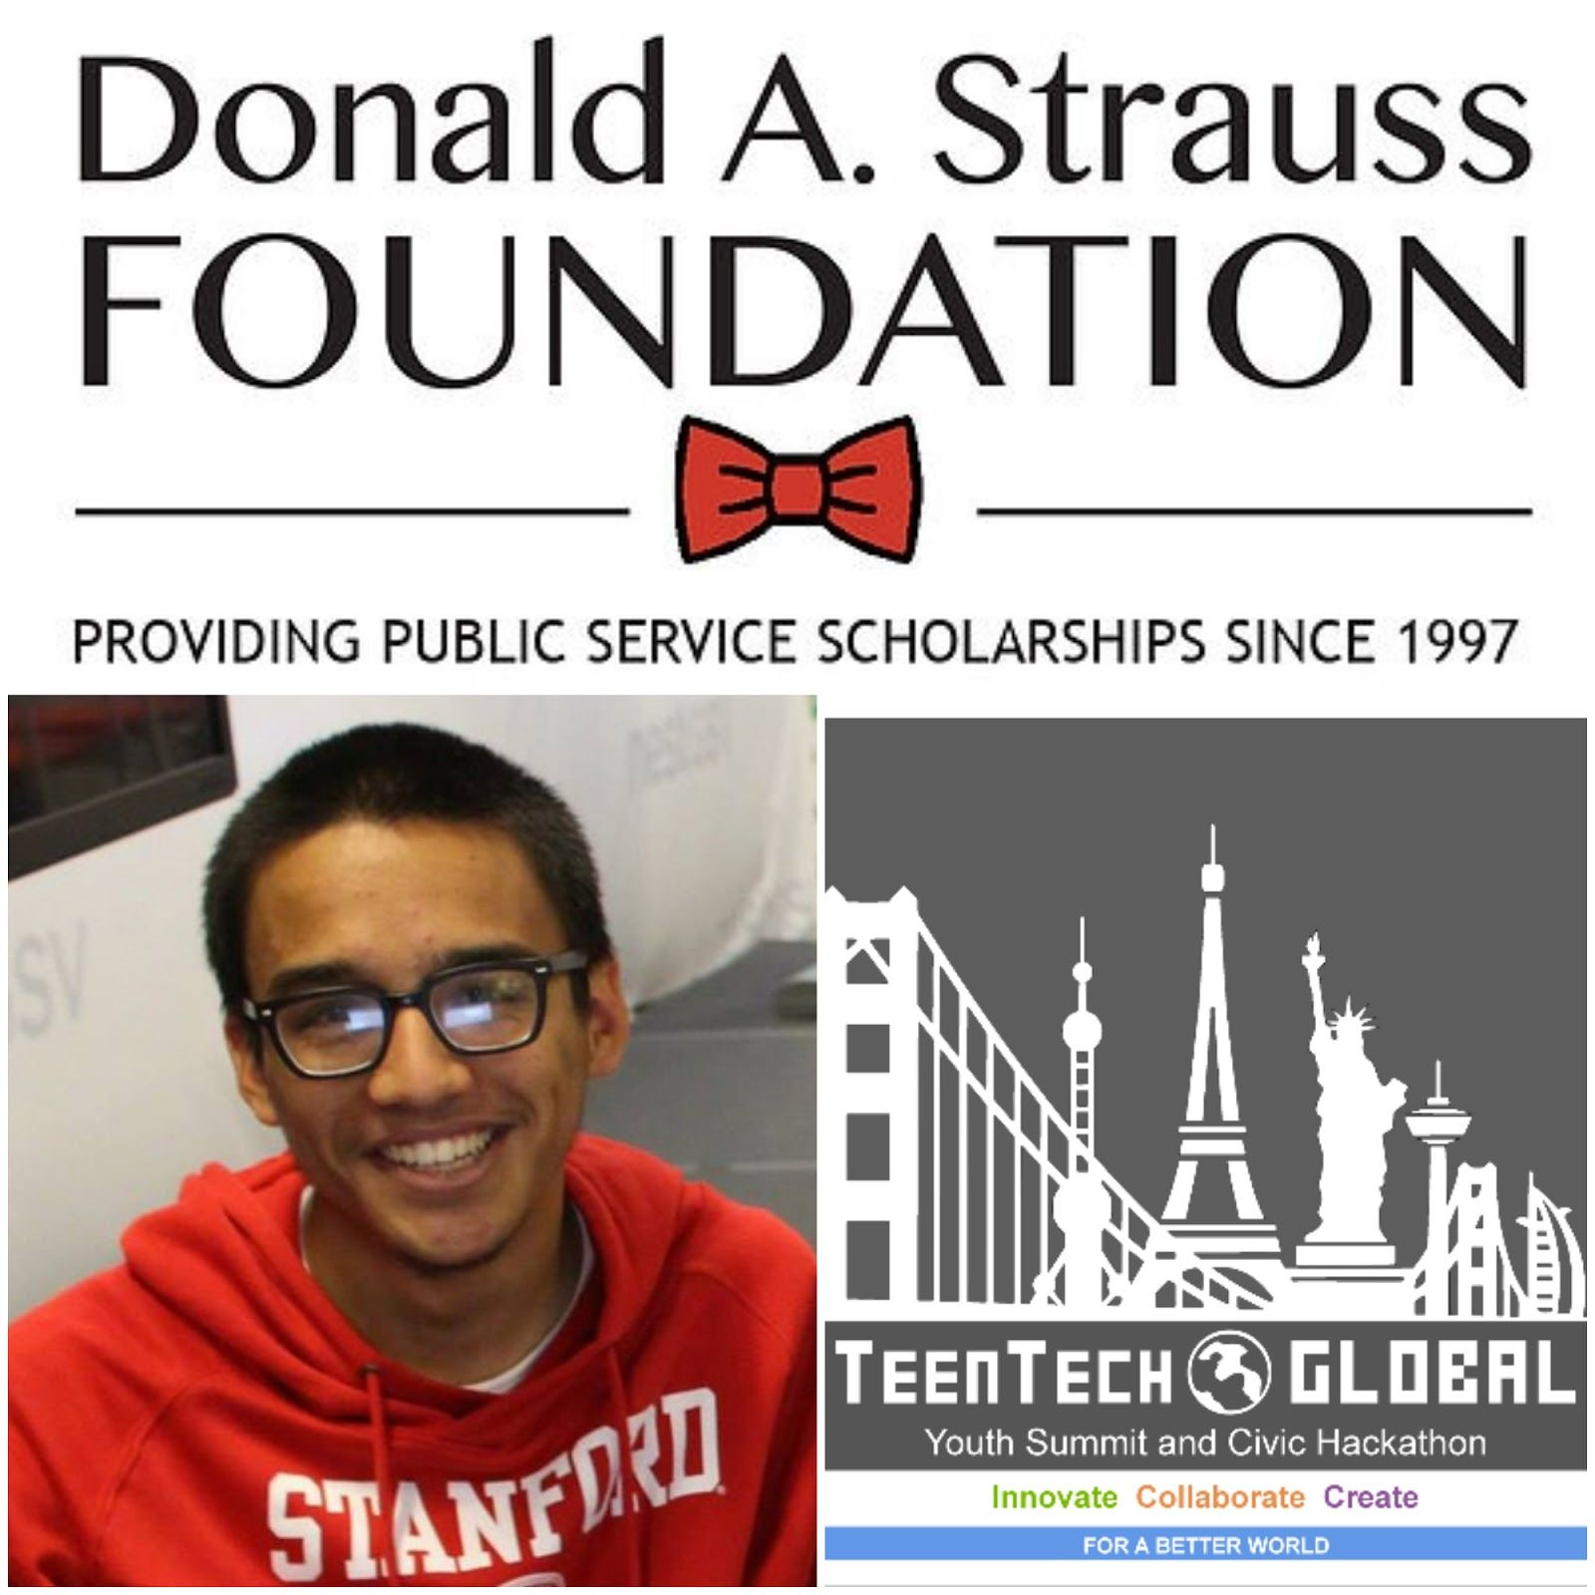
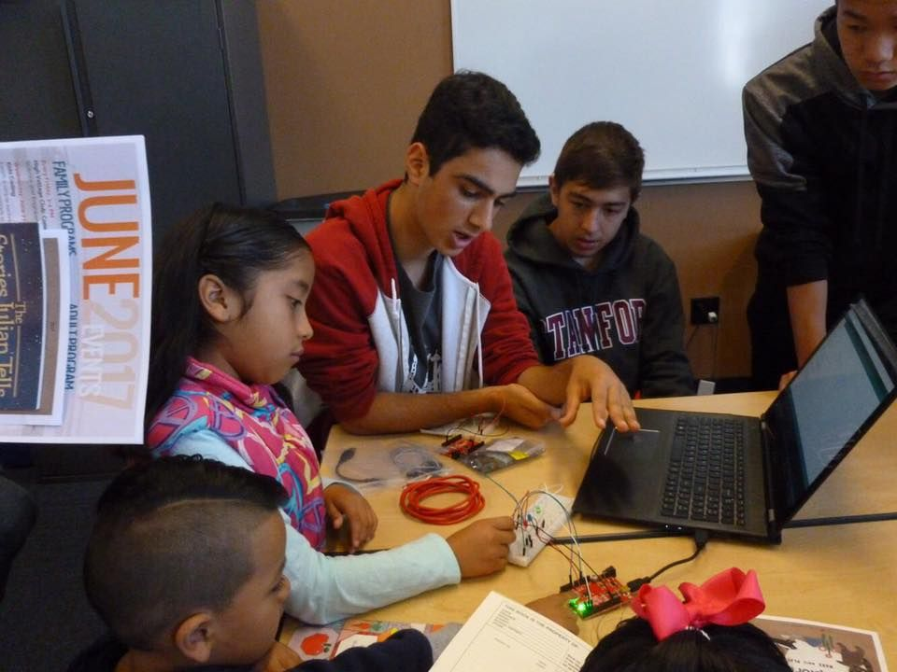
Marc Robert Wong, 2018 Scholar Stanford
Changing the Face of Tech, offering Teens
Conferences, Hackathons and workshops
Notes:
Marc Robert Wong- 2018 Scholar Stanford- TeenTechSF: Changing the Face of Tech, Changing the World

Slide 10
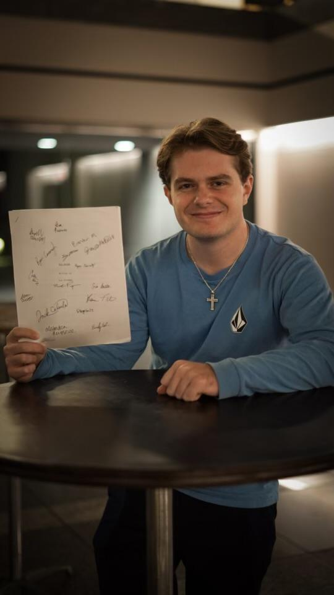
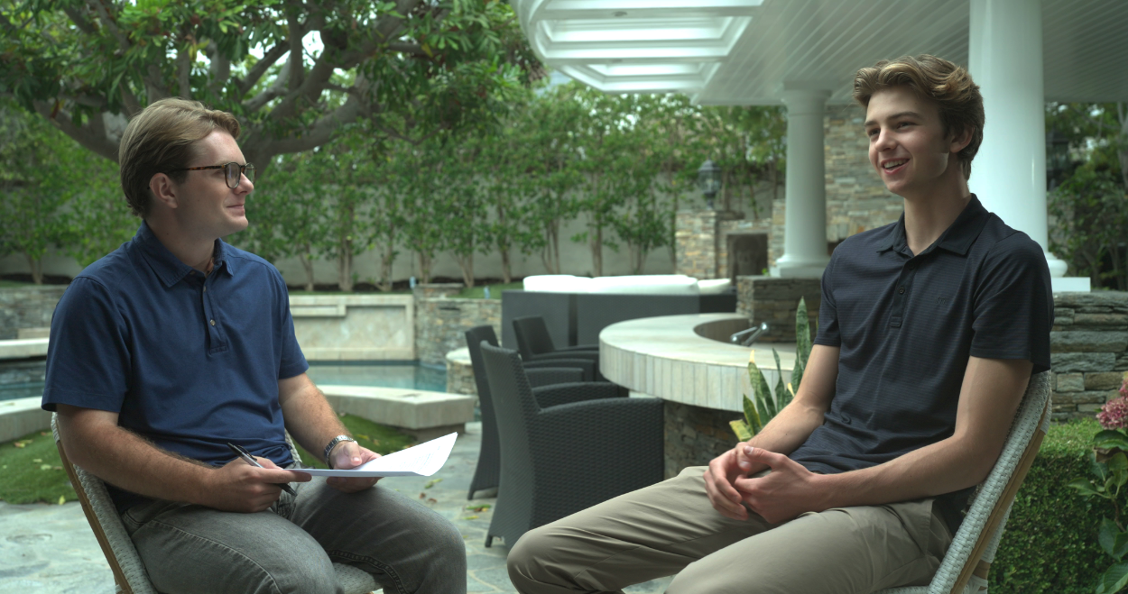
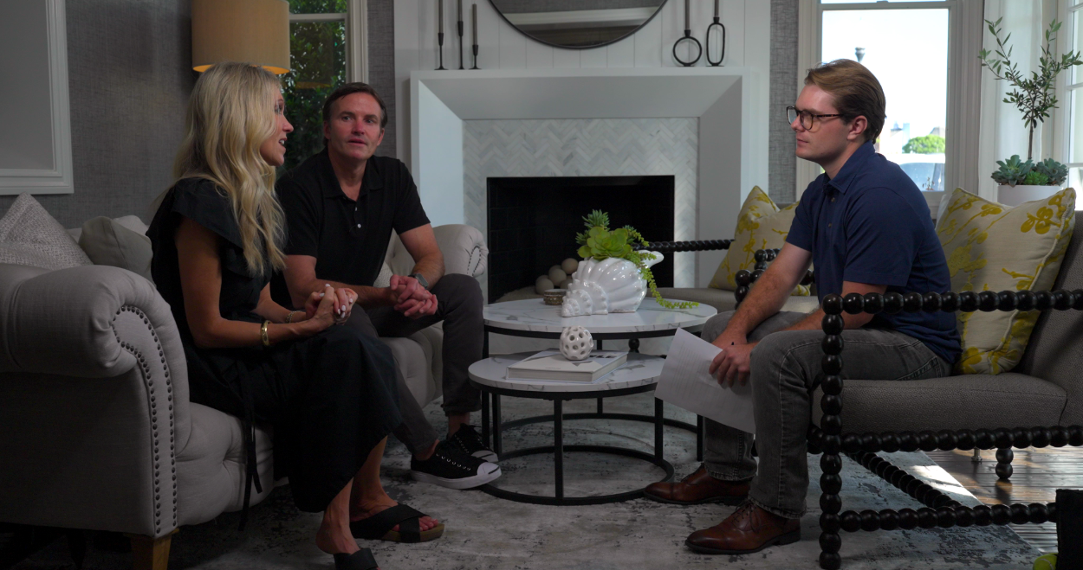
Heart2heart: A Digital Community for CHD Families
Maxwell Page, 2024 Scholar - Loyola Marymount
Notes:
Ryland King- 2011 Scholar U C Santa Barbara- Environmental Education for the Next Generation

Slide 11
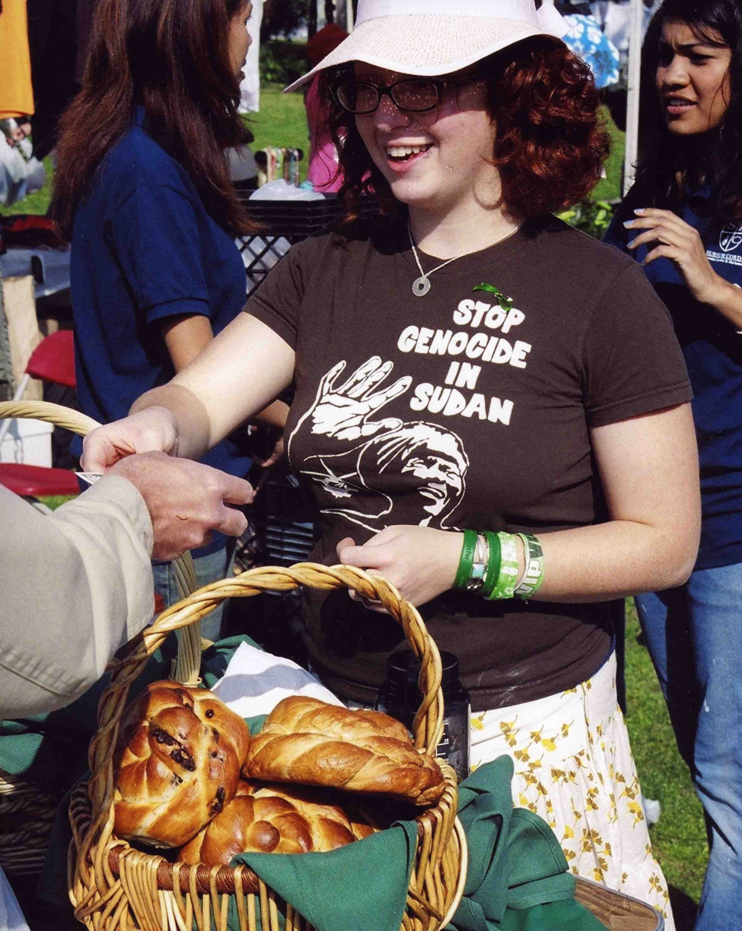
Eli Winkelman, 2006 Strauss Scholar - Scripps College
Challah For Hunger
Baking Challah bread in community and selling it, Eli’s organization raised awareness of the horrific conditions in the Darfur area of Sudan. They donated the proceeds to relief efforts for people starving in the region, offering discounts to students who wrote a postcard to their representatives in Congress.
Notes:
Eli Winkelman- 2006 Strauss Scholar from Scripps College- Challah For Hunger

Slide 12
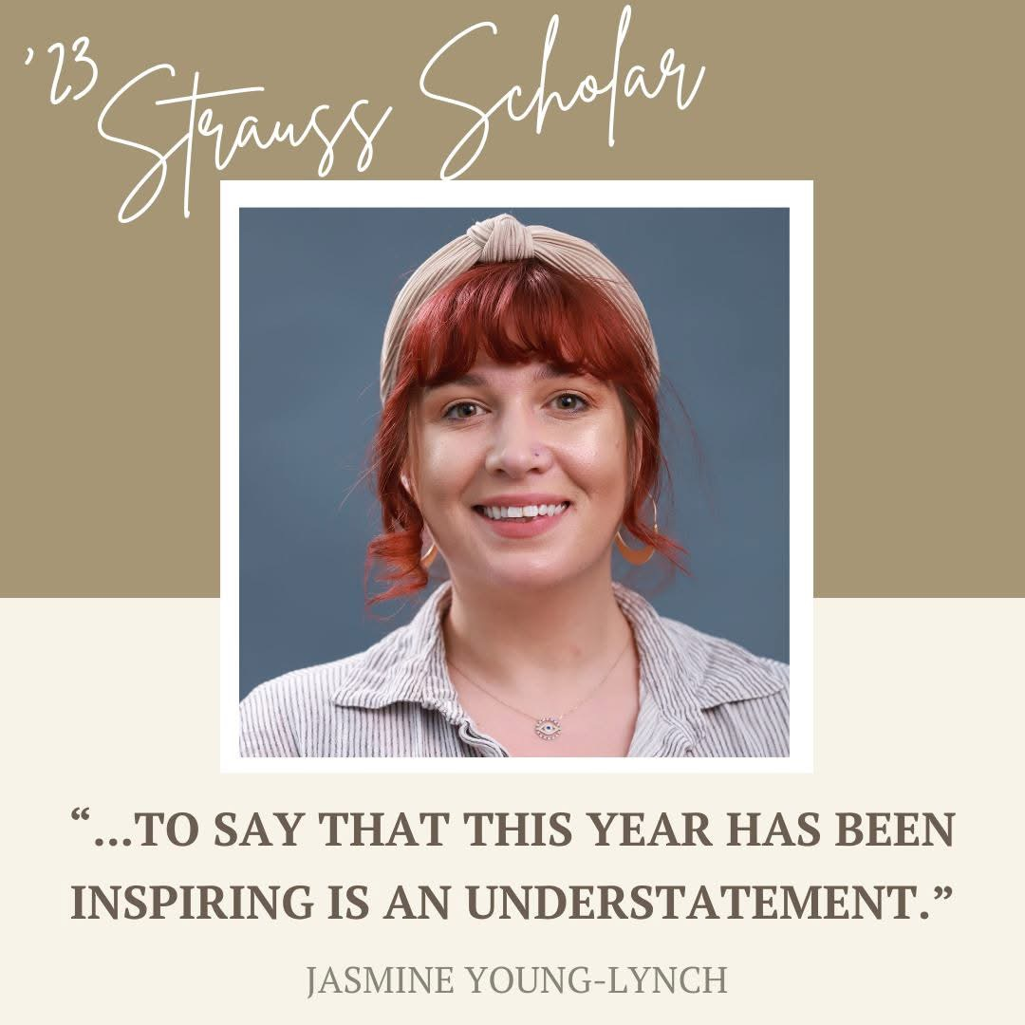
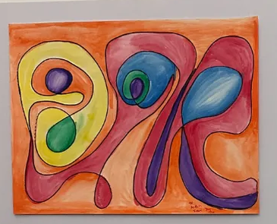
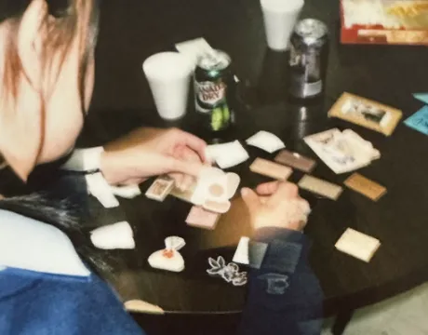
Facilitating Creative Healing for Forgotten Families
Jasmine Young-Lynch, 2023 Scholar - Pomona College
Notes:
Ryland King- 2011 Scholar U C Santa Barbara- Environmental Education for the Next Generation

Slide 13
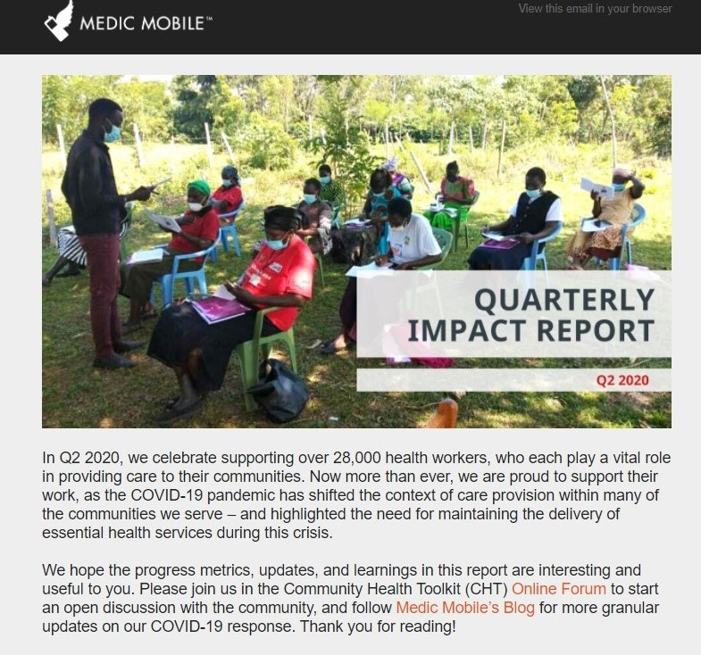
Josh Nesbit, 2008 Scholar
Stanford University
Expanding the Role of HIV-Positive
Community Health Workers:
a communication initiative in Rural Malawi
Josh introduced an SMS language, for use on existing cell phones,
tailored for medical reporting.
Notes:
Josh Nesbit, 2008 Stanford Strauss Scholar- Medic Mobile

Slide 14
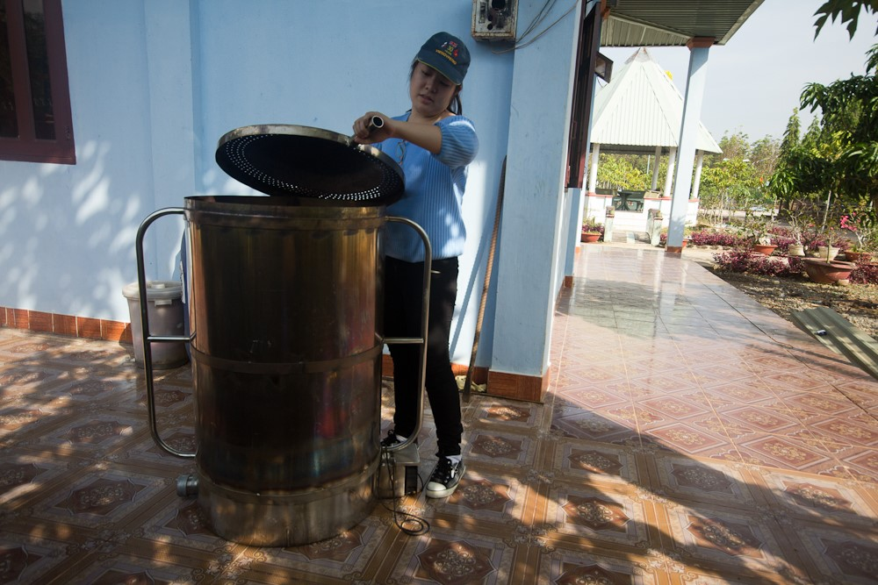
Ivy Nguyen,
2012 Scholar Stanford
Locally designed, sustainable water filtration solutions in Dong Nai province, Vietnam
Sustainability required a source of charcoal. She installed a Corn Husk Gasifier, creating a job for a member of the community.
Notes:
Ivy Nguyen- 2012 Scholar Stanford

Slide 15
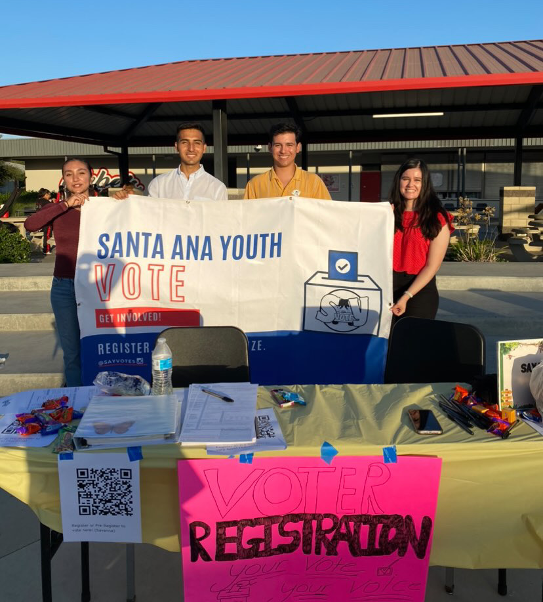
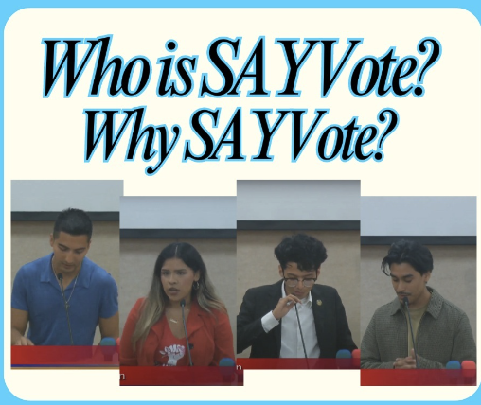
Santanero Voter Initiative:
Uplifting Latino Youth Voices in Santa Ana
Diego Sarmiento, 2024 Scholar - UCLA
Notes:
Ryland King- 2011 Scholar U C Santa Barbara- Environmental Education for the Next Generation

Slide 16
What’s In the Project Proposal?
Explain the social change or service objective, and your innovative means to achieve it.
Provide a plan and timeline which covers the academic year until April--rather than summer- only activities or projects involving one day events.
Provide a plan to mobilize others in the program; younger students will ensure sustainability.
If undertaken with a partner organization, outline the mutual agreement reached and provide a verification letter.
Explain how you will measure success, i.e. the number of people impacted, the number of students mobilized, the results produced.
Have a plan to ensure sustainability of the program.
Have a budget of $15,000, which includes up to $7,000 in Scholarship and at least $8,000 for project expenses.

Slide 17
What Projects Impress Us?
Projects focused clearly on social change / public service / social entrepreneurship.
  It is not the intention of the Foundation to fund internship requirements, research, or creation of a publication
A demonstrated connection between the project and the applicant’s passion, life experience.
Projects that are innovative and timely; an idea, angle or approach that has not been pursued widely and /or that addresses important current issues.
  If the project is an expansion of an existing program, there should be a clear demonstration of new features or major additional outreach or impact.
We like to see a “multiplier effect”. Projects which engage other students or local participants in public service.
  Tutoring/school-based projects need to be scalable- multiple classes or ideally, multiple schools.
Sustainability and Continuity
  Projects sustained over the school year, rather than one or two- day events or only summer projects.
  Plans for future leadership and a timeline for implementation afterwards.

Slide 18
How Do I Apply?
If you have a Campus Representative or Scholarship office, please reach out to them for guidance and feedback on your application. We hope scholars will have professors, advisors, friends who can give them feedback. And email any questions you have to us, as well - admin@straussfoundation.org
Submit your application directly to the Strauss Foundation. See our website for details - www.straussfoundation.org
The deadline for applications is February 9, 2026.
The Board of Trustees of the Donald A Strauss Foundation reviews the proposals, makes the selections and notifies the students in mid-April 2026. In the months that follow, $13,000 of the funds will be available, and the final $2,000 will be given at the April 2027 Presentations.

